Slide 1


Presentation on
Explainable Price Prediction of Consumer Electronics in Bangladeshi E-Commerce
Presented By
Md. Samiul Alam
Program: B.Sc. in CSE (HSC)
ID: 0322320105101032
Batch: 23ʳᵈ
Semester: 7ᵗʰ
Session: Summer - 2026
To be Assigned
Supervisor
Dept. of CSE, PUB
Supervised By
Department of Computer Science & Engineering
Pundra University of Science & Technology, Bogura – 5800

Slide 2

Outline
  Introduction
  Objectives
  Literature Review
  Problem Statement
  Dataset
  Methodology
  Expected Evaluation Plan
  Exploratory Data Insights
  Beneficiaries
  Conclusion
  Future Work
  References
Friday, August 1, 2025
Department of Computer Science & Engineering, PUB
4

Slide 3
Introduction
  Bangladesh's e-commerce sector has grown quickly, and platforms such as Daraz and Pickaboo are now a primary channel for buying consumer electronics.
  Prices for similar electronics vary widely across platforms, brands, and sellers, and discounts are often inconsistent, making it hard for buyers to judge a fair price.
  Most existing Bangladeshi e-commerce studies focus on customer sentiment or purchase intention; price modelling of electronics listings is largely unexplored.
  This thesis proposes an explainable machine learning framework that predicts electronics prices on Daraz and Pickaboo and identifies which product attributes drive them.
Friday, August 1, 2025
Department of Computer Science & Engineering, PUB
5

Slide 4
Objectives
  To build an explainable machine learning model that predicts the price of consumer electronics listed on Bangladeshi e-commerce platforms.
  To clean and engineer features from raw scraped Daraz and Pickaboo listings, including category, brand, platform, discount, and warranty information.
  To compare Linear Regression, Random Forest, and XGBoost for price prediction using MAE, RMSE, and R².
  To apply SHAP to the best-performing model to identify which attributes most strongly influence electronics prices.
Friday, August 1, 2025
Department of Computer Science & Engineering, PUB
7

Slide 5
Literature Review (1/2)
Title: Yoshi et al. [1] – Real-Time Dynamic Pricing Using Machine Learning: Integrating Customer Sentiment and Predictive Models for E-Commerce
  Contribution:
    Combined transactional, behavioral, and review-sentiment data in one machine learning pricing framework
    Compared Random Forest, Gradient Boosting, Neural Networks, and XGBoost, with XGBoost performing best
    Reported strong accuracy on their retail dataset (MAE 1.29, RMSE 1.65, R² 0.97)
  Limitation:
    Targets real-time, dynamic repricing rather than a one-off, explainable price estimate for an individual product listing
Friday, August 1, 2025
Department of Computer Science & Engineering, PUB
8

Slide 6
Literature Review (2/2)
Title: Toan et al. [2] – Identify and Predict Incorrect Prices by Machine Learning Model
  Contribution:
    Proposed a machine learning approach combined with price analysis to flag e-commerce listings priced incorrectly
    Addressed the difficulty platforms face in supervising prices set by many different retail shops
  Limitation:
    Focused on detecting price anomalies rather than predicting a fair market price from product attributes, and was not evaluated on Bangladeshi data
Friday, August 1, 2025
Department of Computer Science & Engineering, PUB
8

Slide 7
Problem Statement
  Prices for the same or similar electronics vary widely across Daraz, Pickaboo, and different sellers, with discounts that are not always consistent.
  This matters because buyers cannot easily tell whether a listed price is fair, and sellers lack a transparent, data-driven reference when setting prices.
  Online shoppers, sellers, and the platforms themselves are all affected by this lack of price transparency in Bangladesh's electronics market.
  Existing Bangladeshi e-commerce research has focused on sentiment and purchase intention, leaving price modelling of real product listings unexplored.
  This thesis addresses that gap with an explainable machine learning framework that predicts electronics prices and explains what drives them.
Friday, August 1, 2025
Department of Computer Science & Engineering, PUB
9

Slide 8
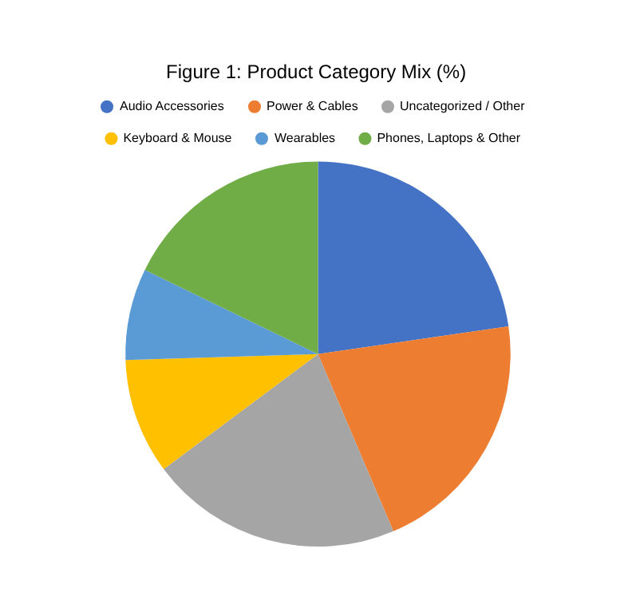
Dataset
  Source: "Bangladeshi E-Commerce Dataset (Daraz and Pickaboo)" on Kaggle, by Fahim Hasan Talukder
  Size: 6,504 scraped product listings, 13 raw fields; 5,998 listings have a usable price after cleaning
  Format: CSV — text fields (name, brand, description) plus numeric price, discount, and rating fields
  Relevance: real electronics prices and discounts from Bangladesh’s two major marketplaces
  Preprocessing planned: parse currency text to numeric prices, derive platform from URL, engineer category, log-transform price
  Limitations: ~28% listings show "No Brand" (mostly Daraz), 506 rows missing price, only ~28% carry a rating
Friday, August 1, 2025
Department of Computer Science & Engineering, PUB
10

Slide 9
Methodology
  Data acquisition: use the 6,504 scraped electronics listings from Daraz and Pickaboo (Kaggle dataset)
  Data cleaning: parse currency text to numeric prices, remove duplicate or incomplete records, and derive the platform from each product URL
  Feature engineering: derive product category and key specifications from product names; encode brand, platform, discount, and warranty type
  Target transformation: use the logarithm of price as the regression target to handle its strong right-skew
  Model training: train and tune Linear Regression, Random Forest, and XGBoost using cross-validation
  Explainability: apply SHAP to the best-performing model to show which features drive its price predictions
Friday, August 1, 2025
Department of Computer Science & Engineering, PUB
11

Slide 10
Expected Evaluation Plan
Table 1: Planned Model Comparison and Explainability Plan
Model | Role in the Study | Evaluation Metrics | Status
Linear Regression | Baseline price predictor | MAE, RMSE, R² | Planned
Random Forest | Non-linear baseline handling categorical features | MAE, RMSE, R² | Planned
XGBoost | Primary gradient-boosted model | MAE, RMSE, R² | Planned
Best Model + SHAP | Explain feature contributions (category, brand, platform, etc.) | Global & local SHAP values | Planned
5-fold Cross-Validation | Check robustness across data splits | Mean ± SD of RMSE | Planned
Friday, August 1, 2025
Department of Computer Science & Engineering, PUB
12

Slide 11
Exploratory Data Insights
  Platform split: 4,536 listings are from Pickaboo and 1,959 from Daraz, out of 6,504 scraped listings in total
  Category mix: audio accessories are the largest group (~23%), followed by power & cable accessories (~21%) and keyboards & mice (~10%)
  Price spread: category strongly drives price — median price is about Tk 37,700 for laptops and Tk 22,200 for monitors, versus roughly Tk 500–600 for cables and audio accessories
  Brand coverage: about 28% of listings show "No Brand," concentrated mostly on Daraz
  Rating coverage: only about 1,800 of 6,504 listings (≈28%) carry a customer rating, so rating will be used as a secondary feature
Friday, August 1, 2025
Department of Computer Science & Engineering, PUB
13

Slide 12
Beneficiaries
  Online shoppers: can quickly check whether a listed electronics price is reasonable before buying
  Sellers and platforms (Daraz, Pickaboo, and similar marketplaces): get a data-driven reference for setting competitive prices
  Researchers and students: gain a reusable, cleaned Bangladeshi e-commerce dataset and pipeline for future machine learning studies
Friday, August 1, 2025
Department of Computer Science & Engineering, PUB
14

Slide 13
Conclusion
This thesis proposes an explainable machine learning framework to predict the price of consumer electronics listed on Bangladeshi e-commerce platforms, using real listings scraped from Daraz and Pickaboo. By comparing Linear Regression, Random Forest, and XGBoost, and applying SHAP to explain the strongest model, the work aims to show not just how accurately price can be predicted, but which product attributes — such as category, brand, and platform — drive it. If successful, the resulting model and its explanations can help buyers judge fair pricing and give sellers and platforms a transparent, data-driven pricing reference for Bangladesh’s growing electronics market.
Friday, August 1, 2025
Department of Computer Science & Engineering, PUB
15

Slide 14
Future Work
Planned extensions include enlarging the dataset with more product categories and additional Bangladeshi marketplaces, incorporating product images and specification text as features, and tracking price changes over time to support dynamic rather than one-off price prediction. The pipeline could also be extended into a lightweight web tool that lets shoppers check a fair price range for a product before purchase.
Friday, August 1, 2025
Department of Computer Science & Engineering, PUB
16

Slide 15
References
Talukder, F. H. (n.d.). Bangladeshi E-Commerce Dataset (Daraz and Pickaboo) [Data set]. Kaggle. kaggle.com/datasets/fahimhasantalukder/bangladeshi-e-commerce-dataset-daraz-and-pickaboo
Yoshi, A. M., Rohan, A., Mitu, S. A., Rabbi, M. M. K., Akther, S., & Ahmed, K. R. (2025). Real-time dynamic pricing using machine learning: Integrating customer sentiment and predictive models for e-commerce. International Journal of Advanced Computer Science and Applications, 16(9).
Toan, L. T., Giang, N. X. H., & Thuan, N. H. (2023). Identify and predict incorrect prices by machine learning model. CTU Journal of Innovation and Sustainable Development, 15(2), 35–44.
Lundberg, S. M., & Lee, S.-I. (2017). A unified approach to interpreting model predictions. Advances in Neural Information Processing Systems, 30.
5. Chen, T., & Guestrin, C. (2016). XGBoost: A scalable tree boosting system. Proceedings of the 22nd ACM SIGKDD International Conference on Knowledge Discovery and Data Mining.
Friday, August 1, 2025
Department of Computer Science & Engineering, PUB
17

Slide 16
Thank You.
Any Questions?
Department of Computer Science & Engineering, PUB

